Slide 1
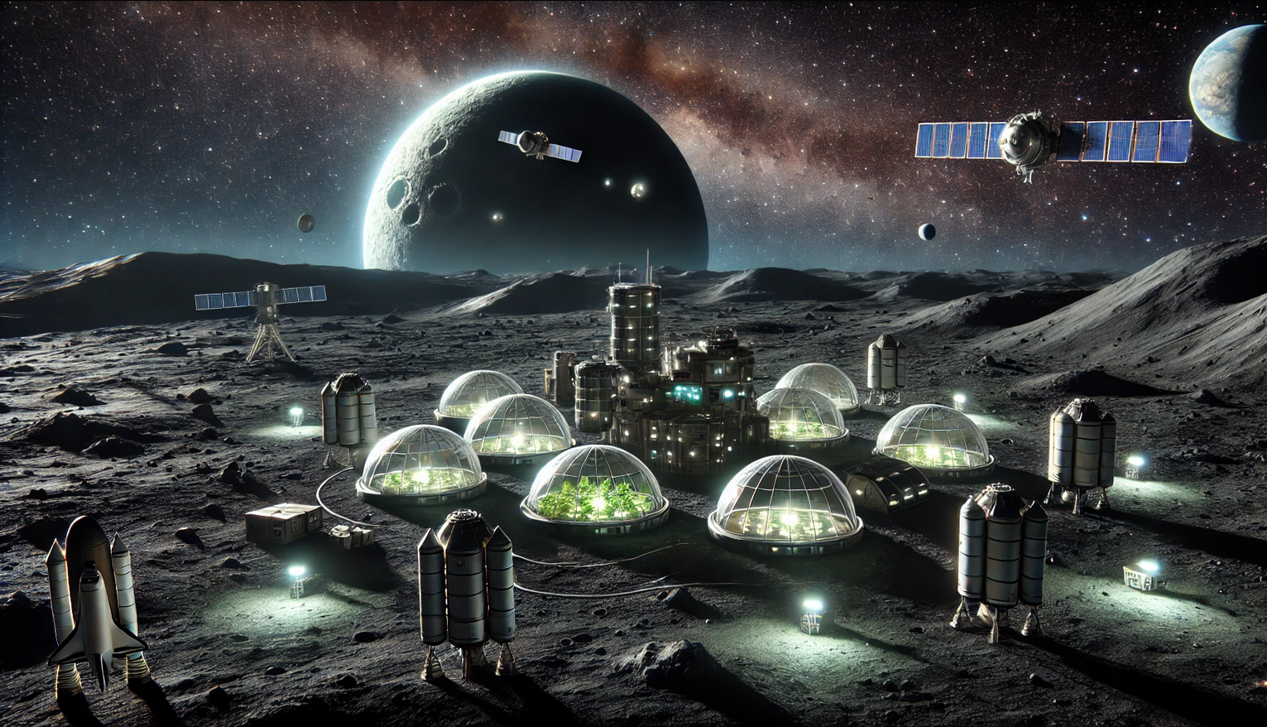
Dark Farmers
I-MBSE Ahmad Shakleya, Berkay Yildirim, Rehmat Khan, Robbe Elsermans

Slide 2
The presentation itself introduces the mission and the system requirements and constraints, the logical architecture, the physical architecture, and the controller. Finally, a small (recorded) demo of the mission is required. Please highlight the different choices you have made during the design and why you made them. Do think about the link with the theory. You will get extra questions that link the presentation and the work with the theory. Your presentation should be around 20 minutes without questions.

Slide 3
Mission
Experimental farm module on the dark side of Mun
Notes:
Our mission is to bring an experimental farm module to the dark side of the mun on order to test if life is possible and what the optimal conditions are.

Slide 4
System requirements and constrains
Bring experimental farm module to Mun
Weight: 4000 Kilograms
Energy: 0.29 EC/s
Provide constant communication between Kerbin and Mun
An emergency communication interval of 10 minutes
A normal communication interval of 30 minutes
3 Mit/s
No return vessel nor reusability of used components
No kerbin onboard
Delta-V of 5150 m/s -> 5922 m/s (+15%)
Budget -> It is in the name of science! (we want to be faster than the Russians)
Notes:
Robbe
For this, we have some system requirements and constrains.
The requirements of our system are:
Bring an experimental farm module that has a weight of 4 ton and needs a certain energy of 0.29 Electric Charge per second
Provide a constant communication medium between Kerbin and the Mun where a 10 minutes interval must be guaranteed for a whole day.
No returning vessel nor reusable components must be used
We do not send Kerbins but only the farm module that is sustainable on its own
Our total trajectory will need a Delta-V of 5150 m/s. For uncertainties, we've added a 15% margin which boils down to a Delta-V of 5922 m/s
As for the budget, it is in the name of science

Slide 5
System requirements and constrains
Budget
ChatGPT-chat
Given budget by: Chief Financial Officer: Lye G. Batenkaitos
Estimation costs
Category | Funds (F)
Farm Module | 45 000
Satellite Network | 12 000
Launch Vehicle | 60 000
Transfer Stage | 25 000
Contingency (10%) | 15 000
Estimation costs | 148 000
Notes:
Robbe
But sadly, we do not have carte blanche, We're given 160 000 funds to spend over our project.
Then, we've made an estimation cost (asked the financial officer) where we can spend what.
We estimated that our most expenses will go to the launch of our rocket and the farm module. Next the satellite network and lastly the transfer stages in space itself.
To account for unforeseen things, we've added a contingency of 10%.
This total cost, is still lower that the budget given.
As we want more contracts in the future, going below the given budget for the same equipement, but optimized, will be remembered hopefully by the stakeholders.

Slide 6
System requirements and constrains
ChatGPT-chat antenna
Farm Power - Decisions
ChatGPT-chat EC
Given energy consumption by: Chief Agricultural Scientist: Regulus G. Corneas
Farm module energy EC/day | 39 765
Module Energy Consumption
Item | EC/Sec | Number | duration/s | Total (Energy) / day
Communotron 16 | 18 | 1 | 231,64 | 4 169.52
Farm Module | 0,28611207 | 1 | 138 984,00 | 39 765
Total EC Consumption 43 934.52 EC/day
Total EC Consumption 0.31611207 EC/day
Notes:
Robbe
The farm module is placed on the dark side of the moon. On this side, we have a half day of sun and a half day of night. Therefore, it is vital to determine the needed EC/second for this whole module.
This module will consist of the farm module which consumes 0.29 ish EC/s and the used antenna that consumes 20 EC/s.
The antenna will only be active each 10 minutes and the farm module will be constantly active. This antenna is selected with the required transmission speed
You may notice that the duration of the Farm module is odd and is not represented as an earths full day. This is because the Mun needs 38 hours for a full rotation and not 24 hours.
All combined gives us an EC/day of approximately 44 000

Slide 7
System requirements and constrains
Farm Power - Decisions
Module Energy Storage
Item | Energy storage (EC) | Number |  | Total capacity (EC)
Big round battery | 4 000 | 6 |  | 24 000
Battery Load (%) | 91.53025
Total charge needed in daytime: | 43 934.52
Module Energy Harvesting
Item | EC/sec | Number | Duration/day (s) | Total harvested energy (EC) | Charge of battery (%)
Gigantor XL Solar Array | 24,4 | 1 | 69 492 | 1 695 604,8 | 3 819,118965
OX-STAT-XL Photovoltaic Panels | 2,8 | 1 | 69 492 | 194 577,6 | 438,2595534
OX-STAT Photovoltaic Panels | 0,35 | 3 | 69 492 | 729 66,6 | 166,0803396
SP-L 1x6 Photovoltaic Panels | 1,64 | 1 | 69 492 | 113 966,88 | 256,6948813
Notes:
Robbe
The needed energy of 44 000 EC per day should be provided also in the night where no sun is present. Therefore, we need batteries that store half the energy needed of a full day.
This is around 22 000 EC. We took a total of 24 000 EC which gives a battery usage of 92.5% in night time.
Of course, in daytime, both the battery as the module must be charged or powered. Therefore, we need double the amount of energy used in the night in order to charge and power everything.
This again will be around 44 000 EC.
We took 3 OX-STAT solar panels that will have a charge rate of 164% so the battery and needed power is plenty available.

Slide 8
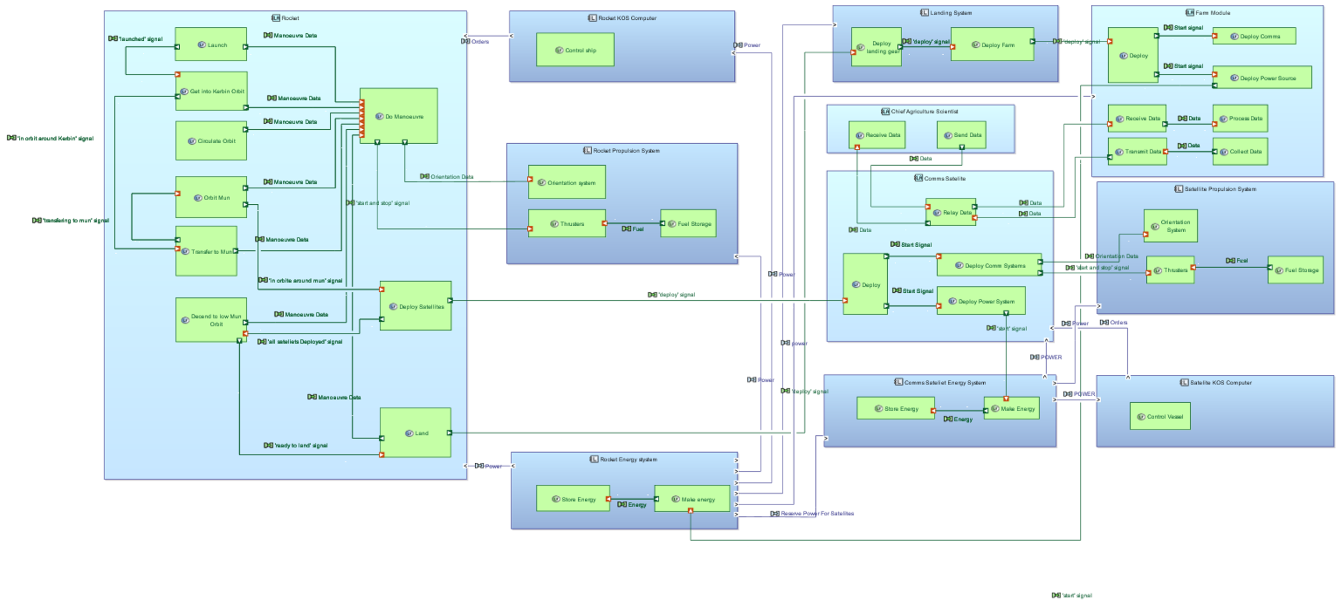
Logical Architecture

Slide 9
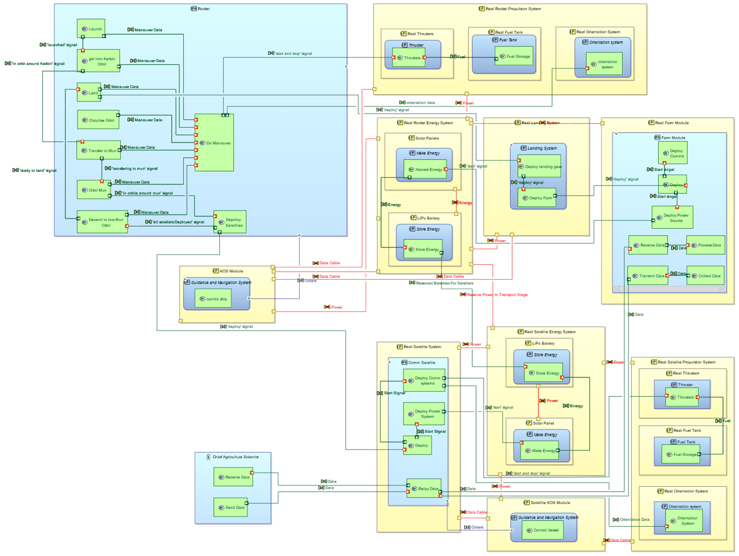
Physical Architecture

Slide 10
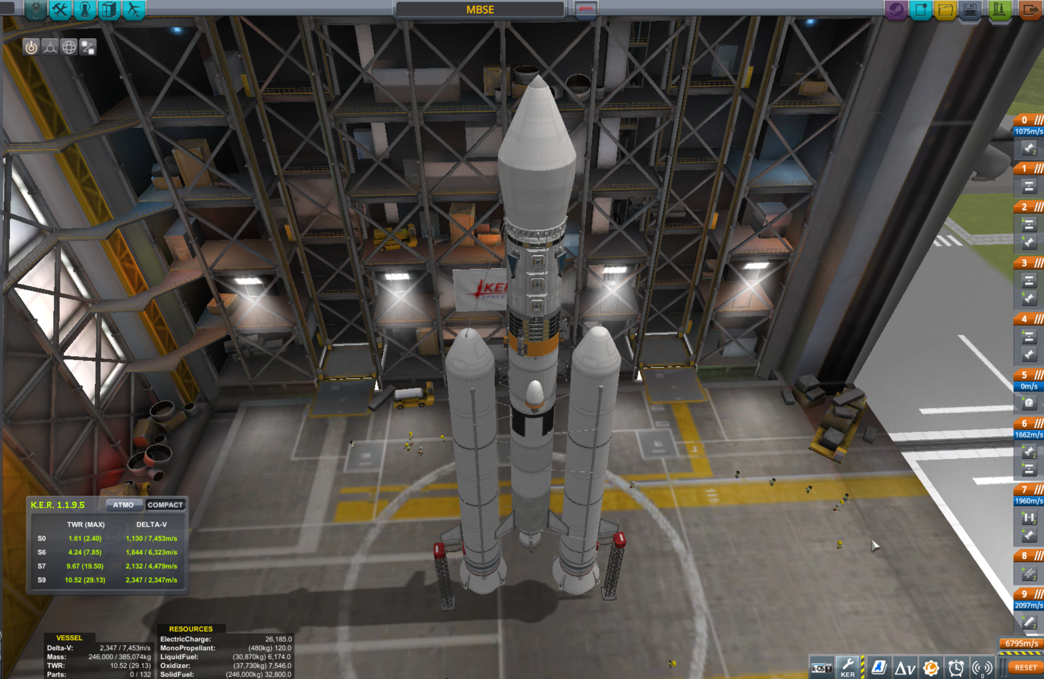
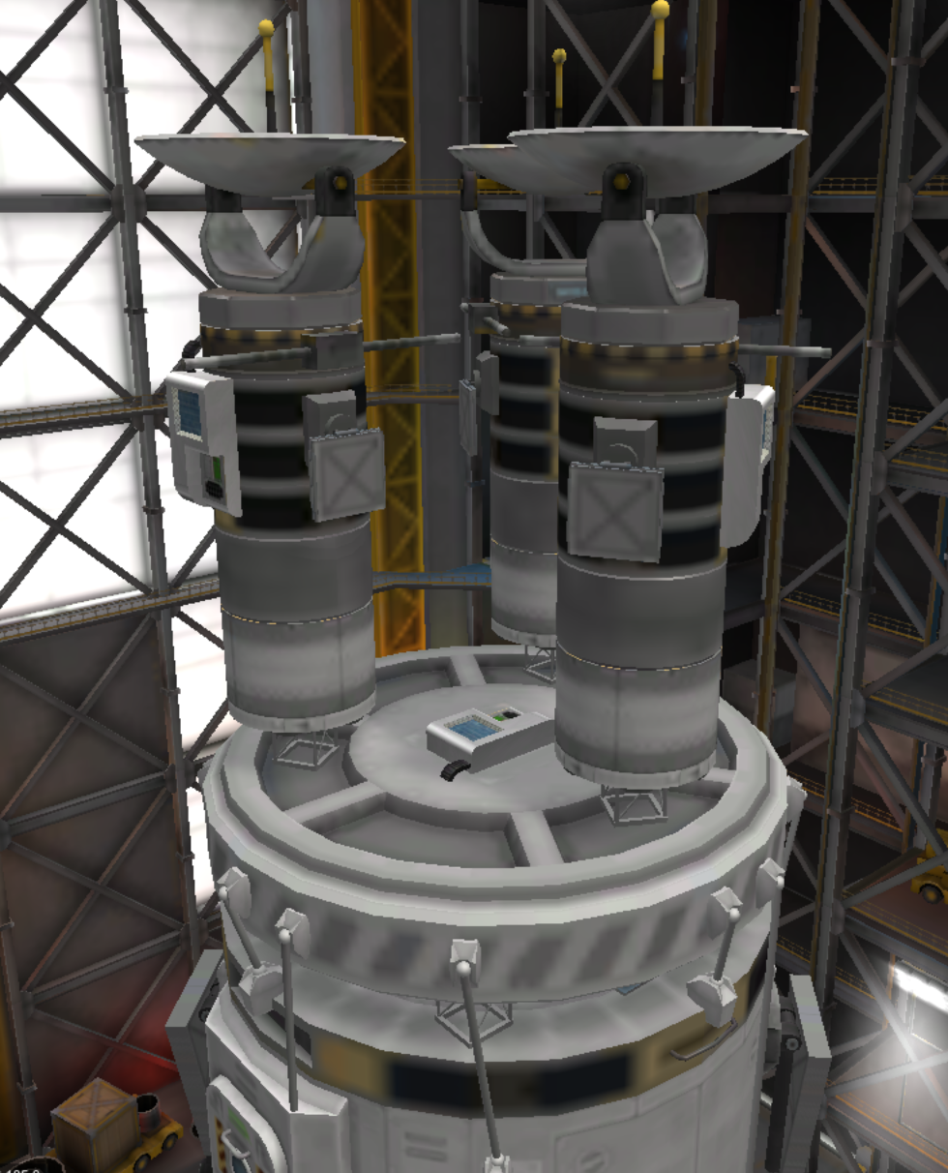
Physical Assembly

Slide 11
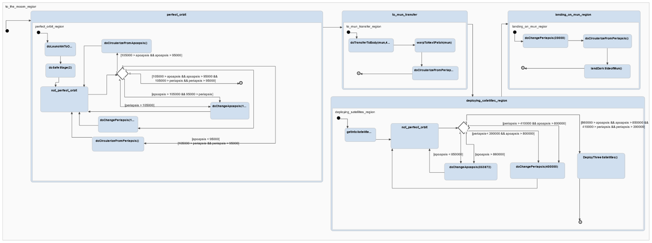
Controller Architecture

Slide 12
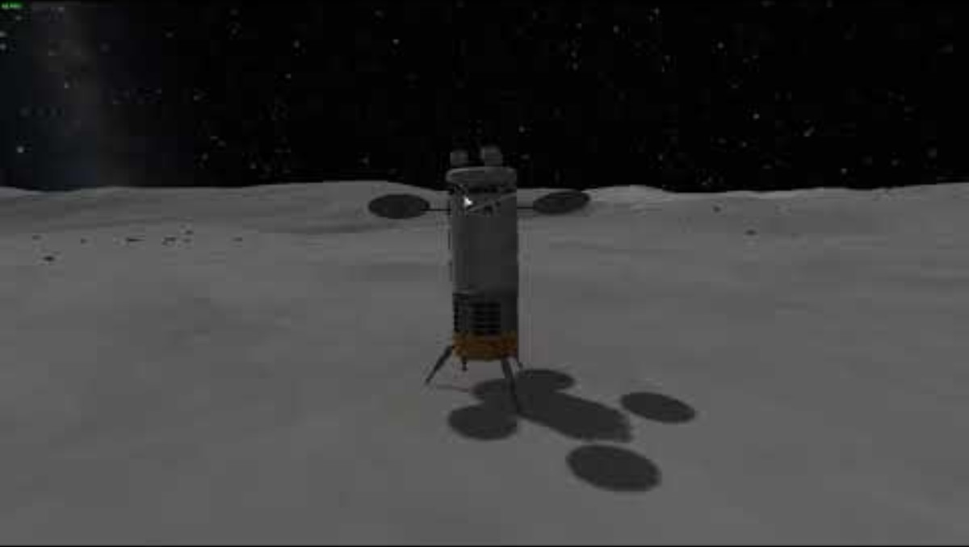
Demo

Slide 13
System requirements and constrains
Excel workdocument
Cost per used part
Part | Amount | Cost | Category | Sub-total
Mk2 Lander Can | 3 | 3202 | Farm Module | 9606
Communotron 16 | 1 | 300 | Farm Module | 300
Z-4K Rechargeable Battery Bank | 6 | 4500 | Farm Module | 27000
OX-STAT Photovoltaic Panels | 2 | 70 | Farm Module | 140
Cubic Octagonal Strut | 7 | 16 | Contingency (15%) | 112
Octagonal Strut | 1 | 20 | Contingency (15%) | 20
AE-FF2 Airstream Protective Shell | 2,5 | 12 | Contingency (15%) | 630
CompoMax Radial Tubeless | 4 | 300 | Contingency (15%) | 1200
TD-06 Decoupler | 3 | 150 | Contingency (15%) | 450
48-7S "Spark" Liquid Fuel Engine | 3 | 240 | Transfer Stage | 720
Oscar-B Fuel Tank | 3 | 70 | Satellite Network | 210
Z-200 Rechargeable Battery Bank | 9 | 360 | Satellite Network | 3240
OX-4W 3x2 Photovoltaic Panels | 6 | 380 | Satellite Network | 2280
Small Inline Reaction Wheel | 3 | 600 | Satellite Network | 1800
Communotron 16-S | 3 | 300 | Satellite Network | 900
Probodobodyne OKTO2 | 3 | 1480 | Satellite Network | 4440
RA-2 Relay Antenna | 3 | 1800 | Satellite Network | 5400
24-77 "Twitch" Liquid Fuel Engine | 2 | 230 | Transfer Stage | 460
TD-25 Decoupler | 1 | 300 | Transfer Stage | 300
Rockomax X200-32 Fuel Tank | 2 | 3000 | Transfer Stage | 6000
TS-25 Stack Separator | 1 | 400 | Transfer Stage | 400
Rockomax Jumbo-64 Fuel Tank | 1 | 5750 | Launch Vehicle | 5750
Mk-55 "Thud" Liquid Fuel Engine | 2 | 820 | Launch Vehicle | 1640
RC-L01 Remote Guidance Unit | 1 | 3400 | Transfer Stage | 3400
RE-M3 "Mainsail" Liquid Fuel Engine | 1 | 13000 | Launch Vehicle | 13000
Delta-Deluxe Winglet | 5 | 600 | Launch Vehicle | 3000
TT-70 Radial Decoupler | 2 | 700 | Launch Vehicle | 1400
S2-33 "Clydesdale" Solid Fuel Booster | 2 | 18500 | Launch Vehicle | 37000
Protective Rocket Nose Cone Mk7 | 2 | 450 | Launch Vehicle | 900
EAS-4 Strut Connector | 39 | 42 | Contingency (15%) | 1638
TT18-A Launch Stability Enhancer | 2 | 200 | Launch Vehicle | 400
LT-2 Landing Strut | 3 | 340 | Transfer Stage | 1020
Budget - Outcome
actual costs
Category | Funds (F) | difference with estimation
Farm Module | 37 0​46 | 7 954
Satellite Network | 18 270 | -6 270
Launch Vehicle | 63 090 | -3 090
Transfer Stage | 12 300 | 2 700
Contingency (15%) | 4 050 | 11 950
Total: | 134 756 F
budget leftover | 25 244 F
Notes:
What did it all cost, as mentioned in the beginning, we made an estimated cost per category. In the final assembly, it is notable that more expenses went to the satellite network and Launch Stage. But, we saved money on the remaining categories which fills each other out.
The total cost was 134 756 F and we have a leftover of 25 244F.

Slide 14



Slide 15
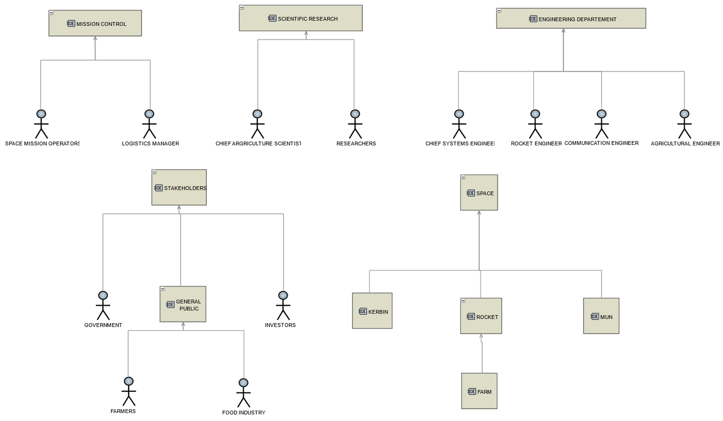
Operational entities

Slide 16
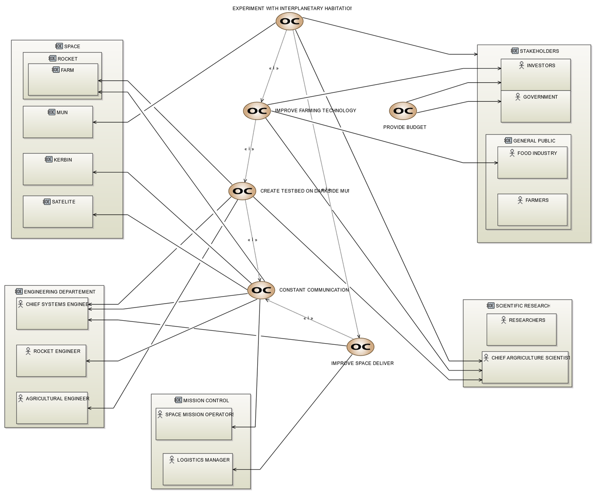
Operational capabilities

Slide 17
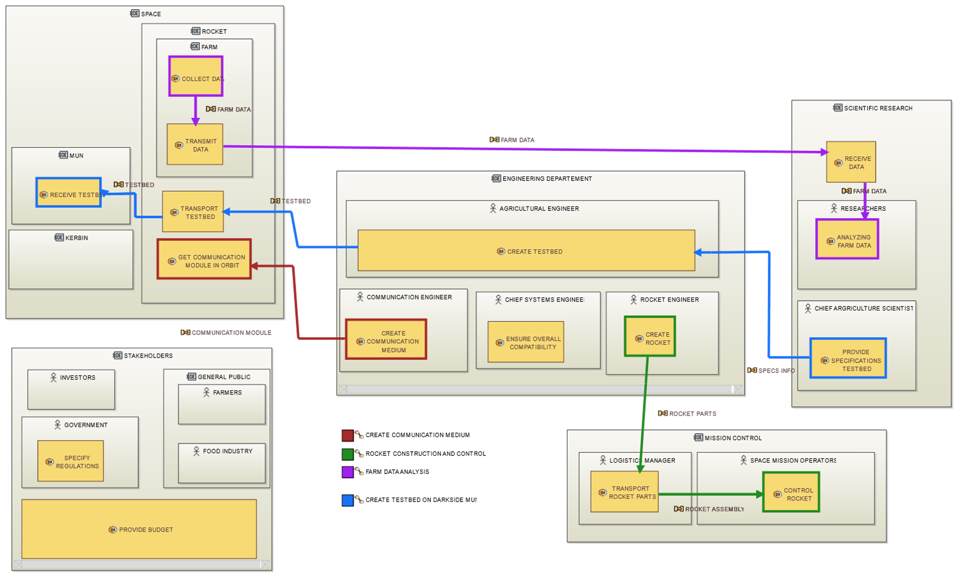
Operational architecture

